Slide 1


CompSci club
Data Structures
Want to get a job in CS? Pay attention.

Slide 2

Our person of the day!
Bill Gates
A man who needs little introduction, no man represents the technology revolution more than perhaps Bill Gates
With Bill’s birthday coming up on Friday, we decided to briefly describe his incredible life story
He was a childhood friend of the late Paul Allen, and the duo would found one of the most consequential companies in history, Microsoft
Holding the title of “Richest person on the Earth” for a large chunk of the 2010s, Gates is actually now removed from many of his business positions
He stepped down as CEO of Microsoft in 2000 and is no longer the largest shareholder since 2014
He also is no longer a part of the board of Microsoft or Berkshire Hathaway
Gates has now devoted himself to life of philanthropy
He plans to give away his entire $113 billion fortune
Co-Founder of Microsoft

Slide 3



Roadmap for Today
What are Data Structures?
Far, far, from being complete, but hopefully, a good overview!
Big O Notation
Hehehehe, Big O.
Why are Data Structures Important?
They may be abstract, but they do have their place!

Slide 4
The 20x Simplified speedrun edition
What are
Data Structures?

Slide 5

The Overview
Simply put, Data Structures are (drumroll, please), is a storage device that can be used to hold data!
Alright, that’s not that exciting, but the main reason why we have data structures is so that we can access that data efficiently
Think of a box
Inside that box, we can theoretically have everything randomly jumbled up and every time we go to box, we have to sift through a new jumble of rubbish to find what we want
Or…. we can just have a set structure that we know how to search (index) through beforehand and that will make it much easier!
With a system, adding and removing data also becomes much easier!

Slide 6

types of Data Structures
There are 2 major types of Data Structures
Linear - Each element is ordered sequentially or linearly, one after another (Arrays, Linked Lists)
A key distinction to make is static vs dynamic data structures; the former can is immutable (better time complexity), the latter is not
Non-Linear - The elements are not placed one after another and we can’t simply pass through all the data in one go (Binary Trees)
We have covered data types before; the main difference being that types can hold a value of a particular type (i.e. string), while data structures can hold multiple data types

Slide 7
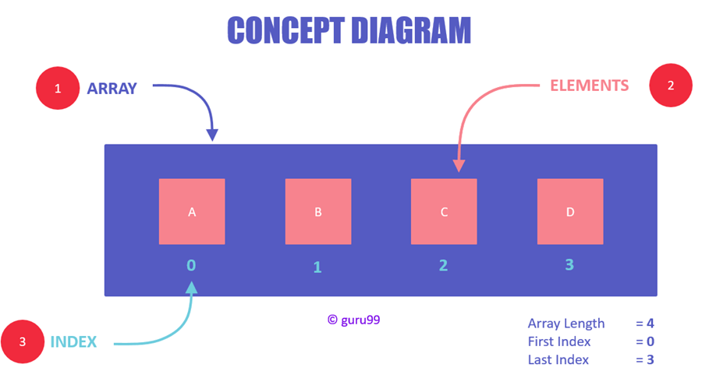
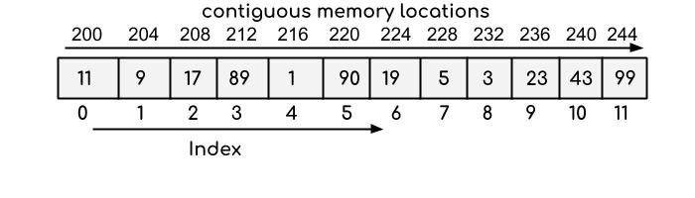
Linear Data Type: Arrays
One of the most common data structures is an array
Each item in an array is stored in contiguous memory locations
They form the bases of other more complex data structures like hashmaps and stacks
Arrays are one of the most versatile data structures
They are heavily used in multiplication, particularly multiplication with matrices
Arrays must be of homogeneous data types, most typically integers or floats
This makes them incredibly useful for indexing, and we can actually access the values of arrays in constant time

Slide 8
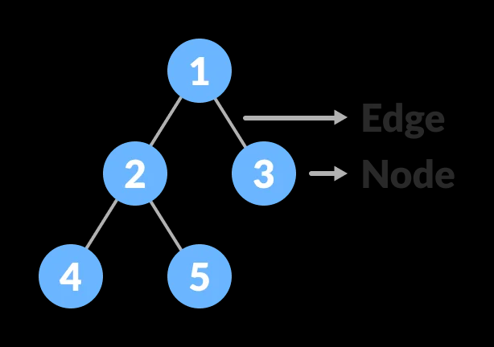
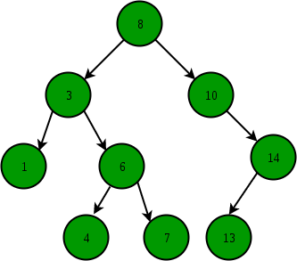
Non-Linear Data Type: Trees
Another incredibly common data structure are trees, which have various different nodes which are connected via edges
In memory, trees are typically stored as another common type of data structure called a linked-list
There are countless variations of trees, with the most common being a binary tree and its close relative, a binary search tree
The primary difference between the trees is the amount of child nodes permitted and the order of the values relative to the nodes around it
Trees can be optimized for indexing and mutation!
A Binary Search Tree
Notes:
Great stack overflow post that goes into the details about how trees are stored in memory! https://cs.stackexchange.com/q/75416

Slide 9
C’mon, you can’t tell us this name isn’t hilarious
Analyzing Data Structures with
Big O Notation

Slide 10
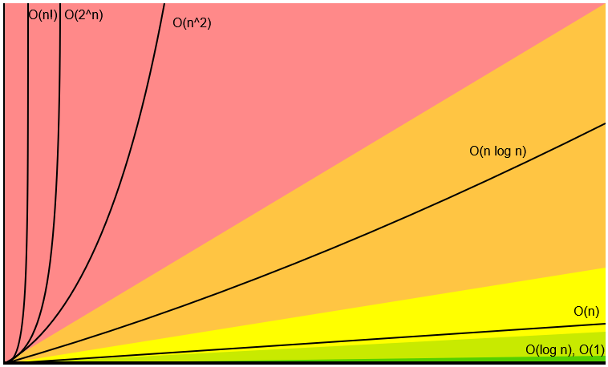
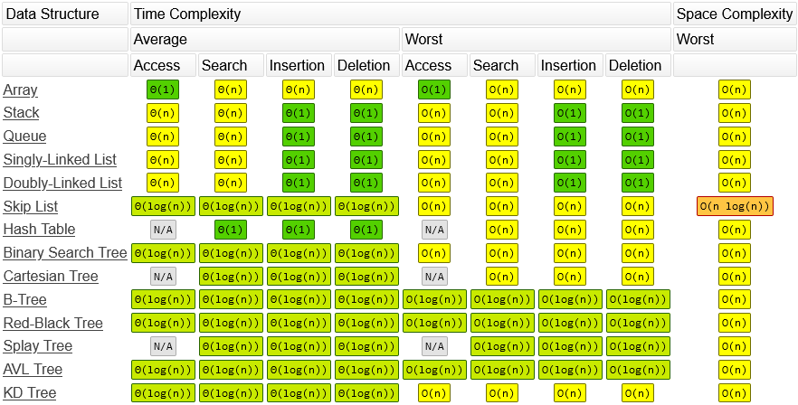
Basics of Big-O
Big-O Notation is a way that we can observe the time complexity of various data structures
The formal definition is: g(n) is O(f(n))” iff for some constants c and N₀, g(n) ≤ cf(n) for all n ≥ n₀
Now that makes zero sense, but essentially what this is saying, what is the upper bound of our function?
In other words, what is the maximum amount of time that this particular piece of code can take we increase the number of inputs?
The graph and table on the right, we can see how different data structures match up against each other in various scenarios
In short, Big O can give us an idea of the best data structures to use given the circumstances
Notes:
Shameless Plug if you want to learn more: https://drive.google.com/file/d/1bwD5UGjbxDOZFu6ypyTL-kzScHJ56pTh/view?usp=sharing

Slide 11
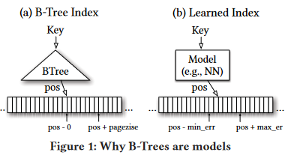
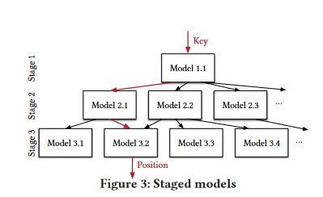
The optimization of learned indexes
One of the coolest breakthroughs in recent decades in data structures is the integration of AI and Machine Learning
For decades, these data structures have remained relatively constant, but these advancement poise to completely change the way we work with large-scale data
The basis of Learned Indexes is that data structures make no assumptions about the data in which they contain, merely acting as a template for various data types
By leveraging the patterns and correlations frequently seen in real-world data, we can have our data structures scale with complexity rather than size
Notes:
CHECK OUT THIS PAPER, IT IS AMAZING: https://www.cl.cam.ac.uk/~ey204/teaching/ACS/R244_2018_2019/papers/Kraska_SIGMOD_2018.pdf

Slide 12
Is this the wrong order to do things in? Maybe
Why are data structures
Important?

Slide 13

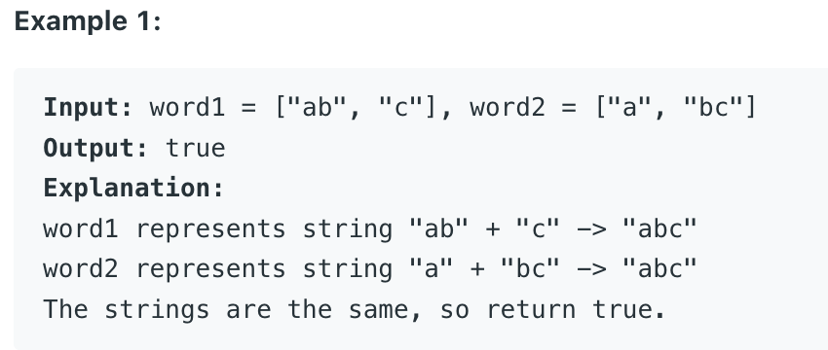
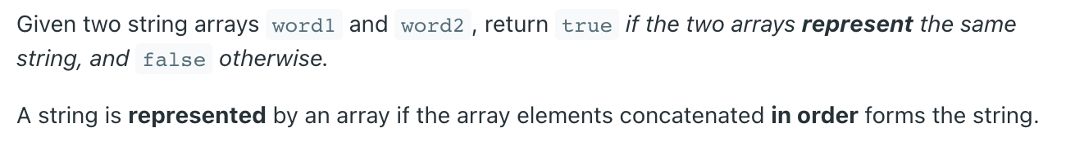
MONEY!!!!
Yeah! You heard (saw) that right! Money! Money for everyone!
If you didn’t know, for interviews at most software companies, especially the top ones, an important factor is the technical interview, which includes a LeetCode style question(s)
Those are generally problems that are reliant only on Data Structures & Algorithms
Here is an example of an “easy” type problem:
This one uses a data structure called array as we just learned!
Notes:
CHECK OUT THIS PAPER, IT IS AMAZING: https://www.cl.cam.ac.uk/~ey204/teaching/ACS/R244_2018_2019/papers/Kraska_SIGMOD_2018.pdf

Slide 14
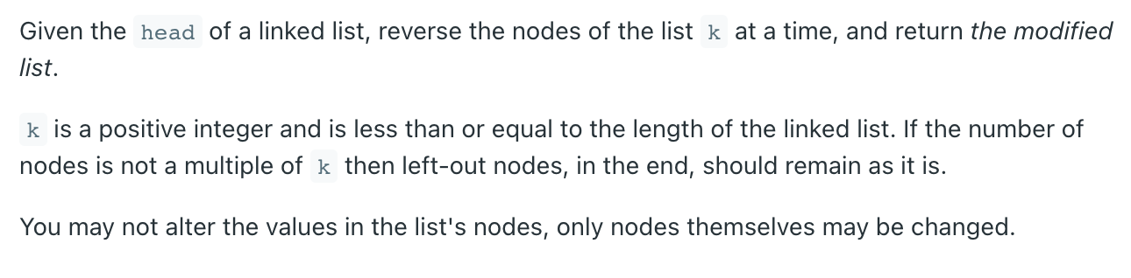
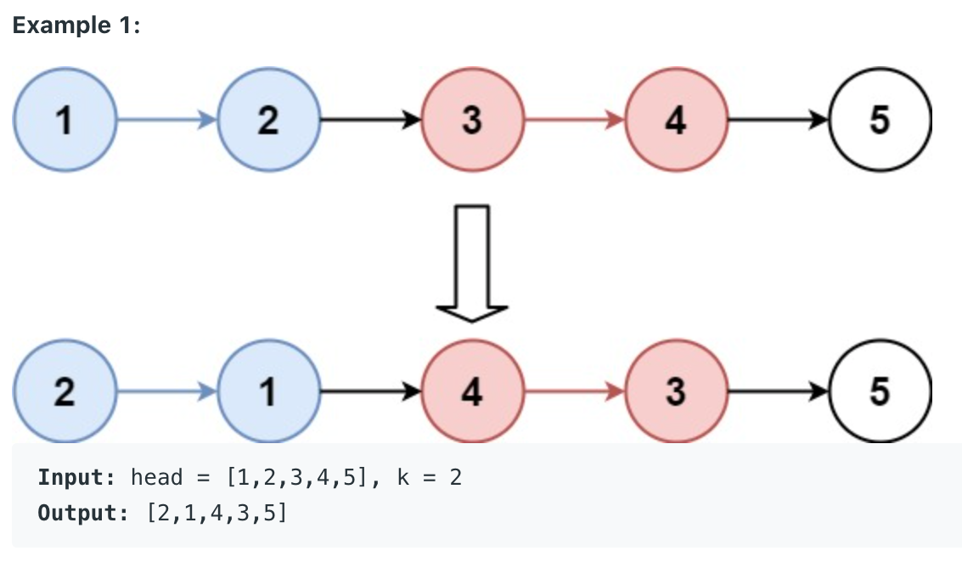
MONEY!!!! Part 1.2
Let’s now take a quick look at a “hard” problem:

Slide 15

Competition!
Another activity that this is used in is: Competitive Programming!
This is where people solve these “leetcode-style” problems in a certain time, and they have to get the shortest amount of time for the actual program to run (Big O notation??) as well as taking up the least amount of memory
Watch 30 seconds of this video of people solving problems
Also watch at 4:57 (This is applicable for HS students)
This guy is super cool and popular in the comp. Prog. community
Notes:
https://www.youtube.com/watch?v=ueNT-w7Oluw

Slide 16


Enterprise!
Don’t you love when your search results come up in 0.47 seconds? Or when you have memory on your device? Or when things load up fast?
Well that is because of data structures (and algorithms)!
We need to store MASSIVE amounts of data efficiently and to do that we need to use the best type of structure
If we don't, the world slows down and we get more of the bad government sites like FAFSA
When you have petabytes on petabytes of data, it needs to be stored in a way that it can be accessed fast (Google) and does not take up too much space and can be easily indexed and then looked at (Google search algos) — That’s why companies pay us the big bucks!

Slide 17
If you have any questions at all, please don’t hesitate to stay back or email one of us!
Thank you!
That is all we have for today!

